Slide 1
Half range expansion of Fourier transform:
Muhammad Shayan Aamir
ID: 13664

Slide 2
What is Half-Range Expansion?
The Half-Range Expansion is used to represent a non-periodic function over a finite interval using Fourier series.
We apply it when the function is defined only over a limited range.
Normally, Fourier series assumes that the function repeats indefinitely. In half-range expansion, we modify the Fourier series so that it only represents the function over a half interval.

Slide 3
Significance:
Representation of Non-Periodic Functions: Half-range expansion allows us to represent functions that are not periodic but defined on a specific interval (like [0,𝐿][0,L]).
Simplified Calculations: Instead of working with full-period functions, we can break down complex problems into simpler parts.

Slide 4
Applications of Half-Range Expansion
Signal Processing: When signals are non-periodic and confined to a limited range, half-range expansion is useful.
Heat Transfer Problems: In cases like a heated bar or wire, the temperature distribution is non-periodic but occurs within a limited range.
Mechanical Vibrations: Analyzing vibrations within a finite interval rather than periodic motion.
Electrical Engineering: Representing currents or voltages that are non-repetitive but occur within a certain time frame.

Slide 5


Formulas for Half-Range Expansion
Half-Range Sine Series (when the function is odd):
For a function f(x) defined on [0,L], the Fourier sine series is:
Where,

Slide 6


Formulas for Half-Range Expansion:
If 𝑓(𝑥)f(x) is an even function, the Fourier cosine series is used:
Where,

Slide 7
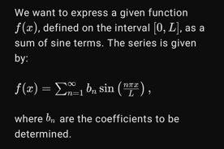
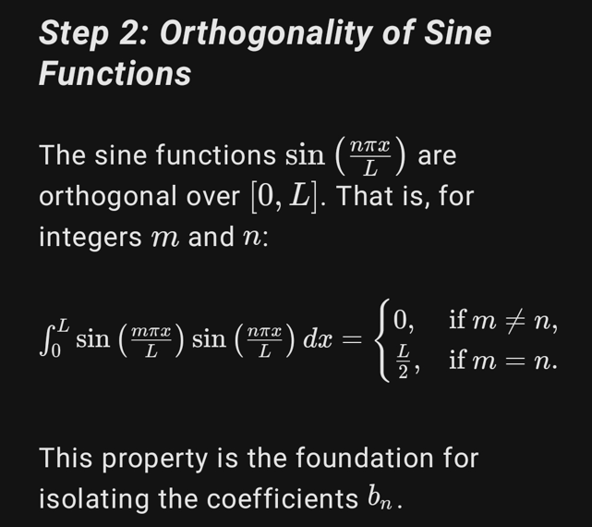
Derivation: Half-Range Sine Series

Slide 8
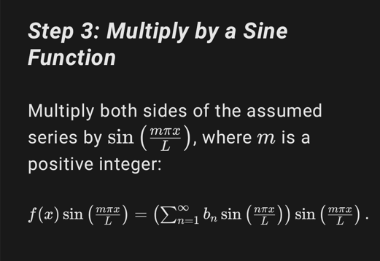
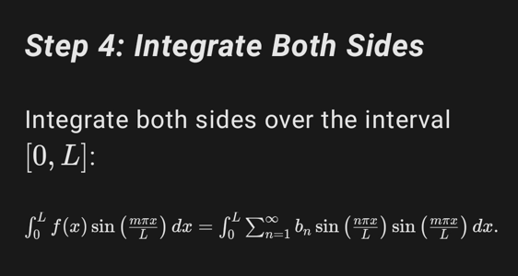
Derivation: Half-Range Sine Series

Slide 9
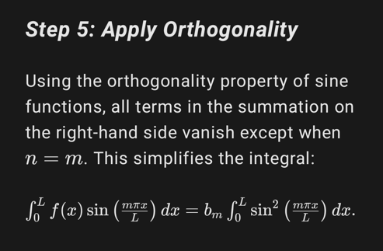
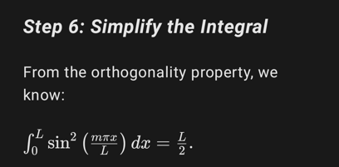
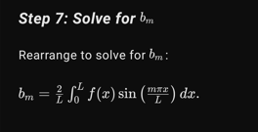
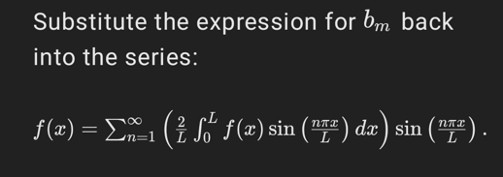
Derivation: Half-Range Sine Series

Slide 10
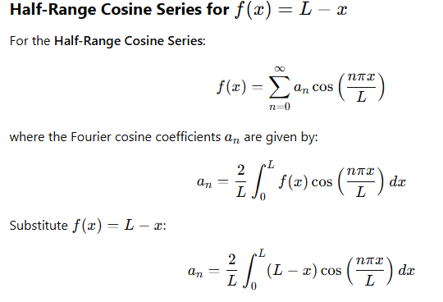
Derivation: Half-Range cosine Series

Slide 11
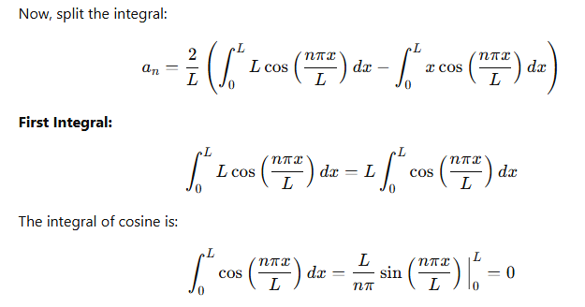
Derivation: Half-Range cosine Series

Slide 12
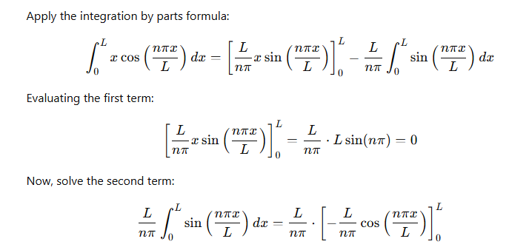
Derivation: Half-Range cosine Series

Slide 13
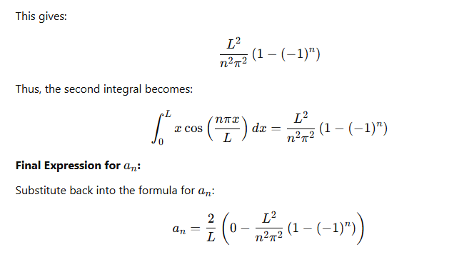
Derivation: Half-Range cosine Series

Slide 14
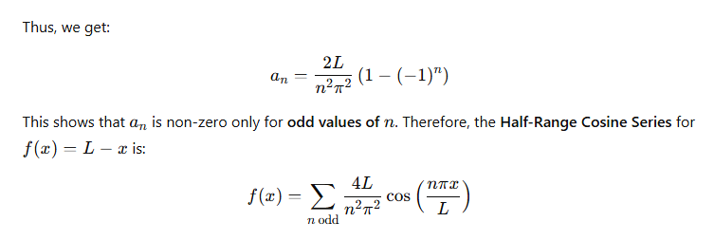
Derivation: Half-Range cosine Series

